Slide 1
Intelligent Agents
Today's Topic: Intelligent Agents
Learning Objectives:
  Understand what an agent is
  Define rationality for agents
  Classify task environments
  Explore different agent architectures
  Introduction to learning agents
"An agent is anything that can be viewed as perceiving its environment through sensors and acting upon that environment through actuators."

Slide 2
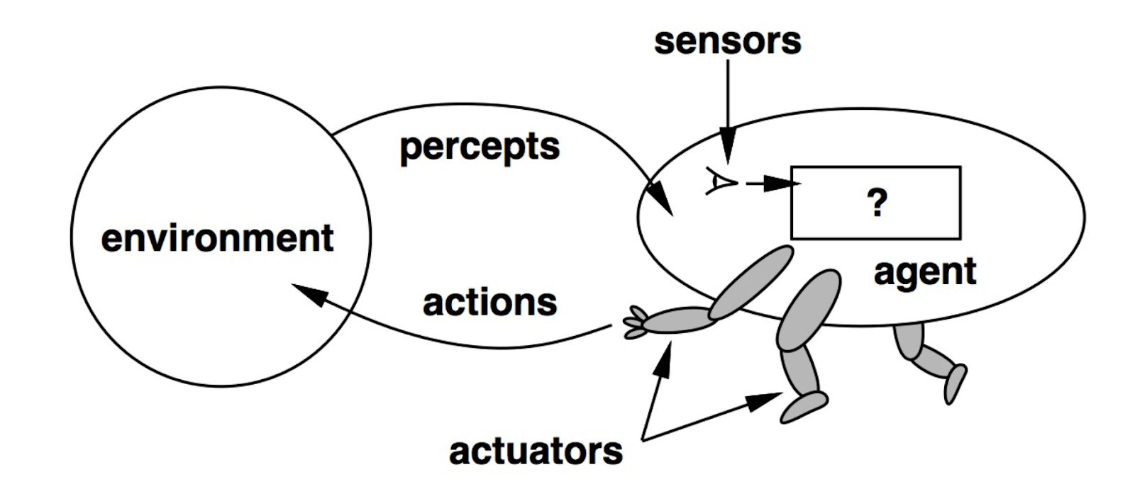
What is an Agent?
Agent = Architecture + Program
Human: Eyes, ears (sensors) | Hands, legs, vocal tract (actuators)
Robotic: Cameras, range finders | Motors, grippers
Software: File contents, network packets | Writing files, sending packets
Key Point: The environment is the part of the universe the agent interacts with

Slide 3
Percepts and Actions
Fundamental Concepts:
  Percept: Content of agent's sensors at any given instant
  Percept Sequence: Complete history of everything agent has perceived
  Agent Function: Maps percept sequences to actions
    f: P* → A
Agent Program: Concrete implementation of agent function
Important Distinction:
  Agent function = abstract mathematical description
  Agent program = runs on physical system

Slide 4
Example - Vacuum Cleaner World
Simple Environment:
  Two locations: A and B
  Each can be Clean or Dirty
  Agent perceives: location and dirt status
Available Actions:
  Turn Left, Turn Right, Pickup Dirt, NoOp
Agent Function (Partial):
  [A, Clean] → Turn Right
  [A, Dirty] → Pickup Dirt
  [B, Clean] → Turn Left
  [B, Dirty] → Pickup Dirt

Slide 5
The Vacuum World - State Space
State Space Properties:
  2 possible locations for agent (A or B)
  2² = 4 possible dirt configurations
    (A clean, B clean)
    (A dirty, B clean)
    (A clean, B dirty)
    (A dirty, B dirty)
  Total: 2 × 4 = 8 states
General n-cell vacuum world:
  n possible agent locations
  2ⁿ dirt configurations
  Total: n × 2ⁿ states
Challenge: As environments grow, explicit tabulation becomes impossible!

Slide 6
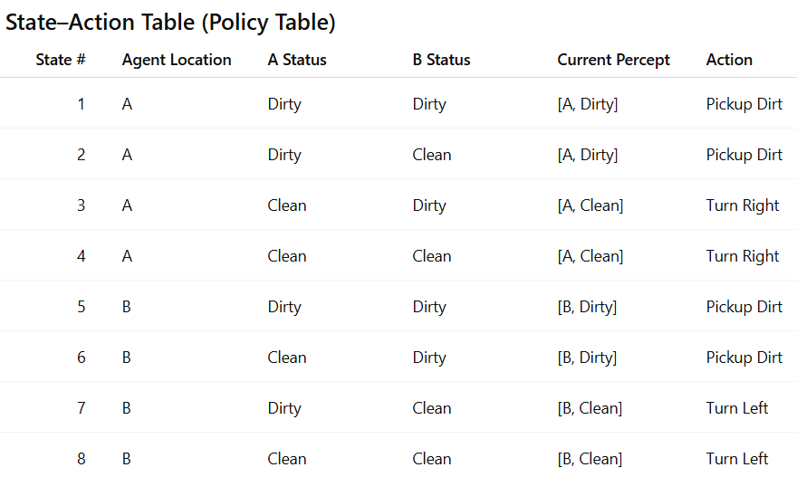
The Vacuum World - State Space

Slide 7
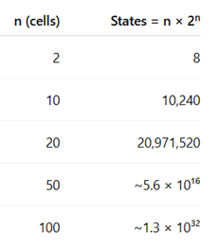
Action Tabulation
If you see this → do that
  State → Action
  One row for each state
But in realistic environments:
  You cannot list all states
  You cannot store actions for every case
  You cannot plan by brute-force enumeration
    Your program cannot be made out of a bunch of if statements or constantly looks up actions in a giant lookup table
Instead of explicit tables, agents must use:
  General rules
  Search algorithms
  Planning
  Learning (ML / RL)
  Function approximation (e.g., neural networks)

Slide 8
What Makes an Agent Good?
Question: How do we fill in the agent function table/policy correctly?
  How do we know what is the correct action is for each situation?
  There is no universally “right” action unless we first define what success means.
The Answer: It depends on:
  What we want the agent to achieve
    Maximum cleanliness, Minimal time, Minimal noise, …etc.
  The environment it operates in
    Are there obstacles? How big is the space?
  The actions available to it
    What the agent can do shapes what it should do.
  What it can perceive
    Limited perception forces different strategies than full observability.
Key Insight: "Good" is defined by consequences, not by the agent's internal reasoning process

Slide 9
Performance Measures
A performance measure is how we evaluate whether an agent is doing well.
A performance measure evaluates the outcomes over time — that is, the sequence of environment states produced by the agent’s actions.
It does not judge:
  how clever the agent is,
  what algorithm it uses,
  or whether it reasons like a human.

Slide 10
Performance Measures
Example - Vacuum World:
  Bad Performance Measure:
    Reward for dirt cleaned up
    Agent could dump dirt and clean repeatedly!
      So the agent is optimizing the reward, not the real goal.
      This is an example of reward hacking or perverse incentives.
  Good Performance Measure :
    +1 point per clean square at each time step
      encourages keeping the environment clean over time
    Penalty for electricity consumed
      discourages unnecessary movement or cleaning
    Penalty for noise generated
      discourages excessive operation
Golden Rule:
  Design performance measures according to what you want achieved in the environment, not how you think the agent should behave

Slide 11
Rationality - Formal Definition
A rational agent:
  For each possible percept sequence (i.e., entire history), selects an action that is expected to maximize its performance measure, given:
    The evidence provided by the percept sequence
    Whatever built-in knowledge the agent has
      models of how the world works
      probabilities of events
      rules of physics
      …etc.
Four Factors Determining Rationality:
  The performance measure (Rationality is always defined relative to goals.)
  Agent's prior knowledge of environment
  Actions agent can perform (cannot be blamed for not doing what it can’t do)
  Agent's percept sequence to date (i.e., experience)

Slide 12
Rationality vs. Omniscience (om-NISH-uhns)
Rational ≠ Perfect
A rational agent:
  may make mistakes
  may fail
  may have incomplete information
But it still acts optimally given its knowledge and perceptions.
This avoids confusing:
  rationality with omniscience (knowing everything)
  which is an important distinction in AI theory.

Slide 13
Rationality vs. Omniscience (om-NISH-uhns)
A rational agent Does the best possible thing it can, given what it knows and what it can do.
  it answers the question:
    “What is the best action based on my information right now?”
An omniscient agent always knows the true state of the world and the exact outcome of every possible action.
  So it always chooses the action that leads to the best actual result, not just the best expected one.
Scenario: Crossing the street
  You look both ways (no traffic visible)
  Start crossing rationally
  Cargo door falls from a plane at 33,000 feet
  You are flattened
Were you irrational? NO!

Slide 14
Rationality vs. Omniscience (om-NISH-uhns)
Key Distinctions:
  Rationality
    Maximizes expected performance
    Based on probabilities and evidence
    What AI agents can aim for
  Omniscience
    Maximizes actual performance
    Requires perfect future knowledge
    Physically impossible
  Perfection
    Means never making mistakes
    Impossible in uncertain environments
  So:
    Rational agents can fail and still be rational.

Slide 15
Rationality Requires Intelligence
A Rational Agent Should:
  Gather Information
    Good decisions require good information.
    If the agent does not know enough about the current situation, it should try to reduce uncertainty.
    Example: Look before crossing the street
    Exploration in unknown environments:
      explore new areas
      try actions to learn what happens
    essential in:
      robotics
      reinforcement learning
      game-playing agents

Slide 16
Rationality Requires Intelligence
A Rational Agent Should:
  Learn from Experience
    If an agent keeps repeating the same mistakes, it is not behaving rationally over time.
    A rational agent should:
      use feedback from past actions
      Improve performance over time
    The agent updates:
      its internal model
      or its policy
      or its value estimates
    This is the foundation of:
      reinforcement learning
      adaptive control systems

Slide 17
Rationality Requires Intelligence
A Rational Agent Should:
  Be Autonomous
    does not rely entirely on pre-programmed behavior
    can adapt when conditions change
    If the environment differs from what the designer expected, the agent should still cope.
    Because designers cannot anticipate:
      every situation
      every failure mode
      every new environment
    So rational agents must:
      compensate for incomplete or incorrect prior knowledge.
    This means:
      adjusting strategies
      updating beliefs
      changing behavior when needed

Slide 18
PEAS Description Framework
When we design an AI agent, the first question is not:
  “What algorithm should we use?”
The first question is:
  “What exactly is the agent supposed to do, and in what world?”
    That’s what PEAS helps us define.
Performance:
  This defines what success means for the agent.
Environment:
  This is everything outside the agent that affects it.
Actuators:
  Actuators are how the agent acts on the environment.
Sensors:
  Sensors are how the agent perceives the environment.

Slide 19
PEAS Description Framework
Withou PEAS, we may design:
  the wrong objective
  the wrong model
  or unrealistic capabilities
Example: Automated Taxi Driver
  Performance:
    Safe, fast, legal, comfortable, maximize profits
  Environment:
    Roads, traffic, pedestrians, weather, police
  Actuators:
    Steering, accelerator, brake, horn, display
  Sensors:
    Cameras, radar, GPS, speedometer, microphones

Slide 20
More PEAS Examples
Medical Diagnosis System:
  P: Healthy patient, reduced costs
  E: Patient, hospital, staff
  A: Display questions/tests/diagnoses
  S: Keyboard/voice entry of symptoms
Part-Picking Robot:
  P: % of parts in correct bins
  E: Conveyor belt, bins
  A: Jointed arm and hand
  S: Camera, tactile sensors, joint angle sensors

Slide 21
Properties of Task Environments (1/3)
1. Fully Observable vs. Partially Observable
  Fully: The agent’s sensors provide access to all information needed to make optimal decisions about the current state. E.g., Chess.
    This allows:
      precise planning
      deterministic reasoning
    classical search and planning work well
  Partially: The agent’s sensors give incomplete, noisy, or indirect information about the true state. E.g., Poker.
    So you must:
      estimate probabilities
      reason under uncertainty
    In partially observable environments:
      agents must maintain internal models
      use probabilities
      rely on learning and inference

Slide 22
Properties of Task Environments (1/3)
2. Single-Agent vs. Multiagent
  Single: Only one agent is making decisions that affect outcomes.
    Example:
      Crossword puzzle
      Route planning with static obstacles
    The agent only needs to worry about:
      the environment dynamics
  Multiagent: Other agents exist and their actions affect your success.
    Your performance now depends on what others do, not just what you do.

Slide 23
Properties of Task Environments (1/3)
2. Single-Agent vs. Multiagent
    Competitive: E.g., Chess, poker
      Here, success means:
        reducing opponent’s success
      So agents must:
        predict opponent moves
        use game theory
        plan strategically
    Cooperative: E.g., Taxi driving
      everyone wants to avoid collisions
      follow traffic rules
      reach destinations safely
      So agents must:
        coordinate implicitly
        follow social and legal conventions

Slide 24
Properties of Task Environments (1/3)
2. Single-Agent vs. Multiagent
    Why Agent Interaction Changes Everything
      In multiagent environments:
        the environment is no longer fixed
        it changes based on other agents’ strategies
      So the problem becomes:
        reasoning about other decision-makers, not just physics.
      This leads to:
        game theory
        opponent modeling
        negotiation and coordination strategies

Slide 25
Properties of Task Environments (2/3)
3. Deterministic vs. Nondeterministic
  Deterministic:
    Given the current state and the agent’s action, the next state is completely predictable. E.g., Chess.
    So planning can be:
      precise
      tree-based
      without probabilities
  Nondeterministic:
    The same action in the same situation can lead to different outcomes.
    Examples:
    Driving: braking may not stop at the same distance due to rain or ice
    Medical treatment: same drug, different patient responses
  Note: Partial observability can make deterministic environments appear nondeterministic

Slide 26
Properties of Task Environments (2/3)
4. Episodic vs. Sequential
  Episodic:
    Each decision is independent of previous ones. (e.g., defect inspection)
    The agent’s action affects only the current episode, not future ones.
  Sequential:
    Current actions affect future states and future rewards. (e.g., chess, taxi driving)
    So agents must:
      plan ahead
      consider long-term consequences
      trade off short-term gains vs long-term success
    This leads to:
      search
      planning
      reinforcement learning with delayed rewards

Slide 27
Properties of Task Environments (3/3)
5. Static vs. Dynamic
  Static:
    Environment does not change while the agent is deciding what to do.
    Example: Chess (ignoring the clock) The board does not change while you think.
    This allows:
      long deliberation
      deep search
  Dynamic: Environment changes during deliberation
    Example: Taxi driving:
      pedestrians move
      traffic lights change
      other cars react
    So agents must:
      respond in real time
      interleave thinking and acting

Slide 28
Properties of Task Environments (3/3)
6. Discrete vs. Continuous
  Applies to: states, time, percepts, actions
  Discrete Environment (e.g., chess)
    Everything happens in distinct steps or categories.
  Continuous Environment (e.g., taxi driving)
    Variables change over real-valued ranges, not in steps.
    This makes problems much harder than discrete games.
7. Known vs. Unknown
  Refers to agent's knowledge of environment "laws“
    Not whether the agent knows the current state — but whether it knows the dynamics.
  Known: The agent knows what its actions do and how the world responds (possibly probabilistically).
    E.g., Chess
  Unknown: The agent must learn how the world works through experience.
    E.g., New market conditions in trading

Slide 29
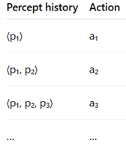
Agent Program Structure
Basic Skeleton:
  pythonfunction AGENT(percept) returns action
  # Takes current percept as input
  # Returns action to execute
  ```
An agent that stores an explicit action for every possible percept sequence it could ever experience
Key Issue: Agent program sees only current percept
  If actions depend on percept history, agent must remember!
Memory Requirements:
  Full table: Σ|P|ᵗ entries (t = agent lifetime, P = number of percepts)
  Completely impractical!
  Example: Taxi with 70MB/sec video = 10⁶⁰⁰'⁰⁰⁰'⁰⁰⁰'⁰⁰⁰ entries!

Slide 30
The Challenge
The Problem:
  Table-driven agents are theoretically correct
  But completely impractical
The Real Solution: Small Programs, Not Big Tables
  Instead of storing answers, we build: compact programs that compute good actions when needed
  These programs use:
    rules
    models
    search
    learning
    value estimation
  They generate behavior, not store it!

Slide 31
The Challenge
So the analogy becomes:
  Can we do for intelligence what Newton did for square roots?
That is:
  Replace massive behavior tables
  With compact algorithms that generate intelligent behavior
Answer: Yes — Through Agent Architectures
This is why AI studies:
  simple reflex agents
  model-based agents
  goal-based agents
  utility-based agents
  learning agents
Each adds more powerful structure so behavior can be produced from:
  small representations
  not massive tables

Slide 32
Four Basic Agent Types
Agent Architectures (Increasing Complexity):
  Simple Reflex Agents
    Respond directly to percepts
  Model-Based Reflex Agents
    Maintain internal state
  Goal-Based Agents
    Use goals to guide decisions
  Utility-Based Agents
    Maximize expected utility
Plus:
  Learning element can be added to any type

Slide 33
Simple Reflex Agents
Characteristics:
  Select actions based on *current* percept only
  Ignore percept history
  Implement condition-action rules
Example Rule:
  if car-in-front-is-braking then initiate-braking
Advantage: Simple, fast
Limitation:
  A simple reflex agent chooses actions based only on the current percept, using rules like:
    If percept = X, then do action = Y
  It has:
    no memory
    no internal model of the world
  This makes it fast and simple, but it also creates serious limitations.Works only if correct decision possible from current percept

Slide 34
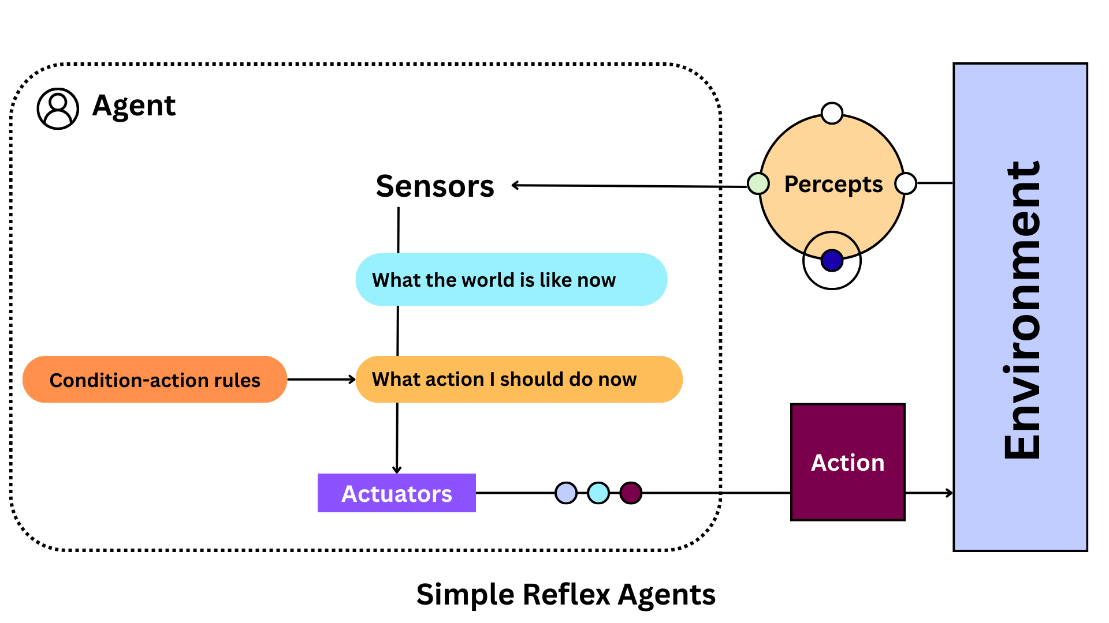
Simple Reflex Agent Architecture

Slide 35
Limitations of Simple Reflex Agents
Problem 1: Partial Observability
  Simple reflex rule: if car-in-front-is-braking then initiate-braking
  The Problem: From a single image/frame, you might see red lights on the car ahead
    Could be: brake lights (braking) ✓
    Could be: just taillights (not braking) ✗
  So the same percept can correspond to different real situations.
  Because the agent has:
    no memory
    no ability to compare with previous frames
  It cannot tell:
    whether the light intensity just changed (braking)
    or stayed constant (normal driving)
  So simple reflex agents fail when:
    the percept does not uniquely determine the true state of the world.

Slide 36
Limitations of Simple Reflex Agents
Problem 2: Infinite Loops
  Scenario: Vacuum agent without location sensor (only has dirt sensor)
  Two possible percepts:
    [Dirty] → Action: Pickup Dirt ✓ (this works fine)
    [Clean] → Action: ??? (what should it do?)
      If it turn right and the area is clean, it will keep turning right forever
  Because the agent
    cannot tell where it has been
    cannot tell where dirt might be
Simple reflex agents:
  cannot resolve ambiguity
  cannot track progress
  cannot plan or explore
They only work well in:
  fully observable, simple, and static environments.

Slide 37
Model-Based Reflex Agents
Key Idea: Keep track of the part of world you can't see now
This is crucial when the environment is:
  partially observable
  noisy
  changing over time
Requires Two Types of Knowledge:
  Transition Model: Tells the agent
    if the world is in state S and I take action A, what state is likely to come next.
      Example: "Turning steering wheel → car turns right“
    changes that happen independently
      Traffic lights change over time even if I do nothing
  Sensor Model: Tells the agent how world state reflects in percepts
    If the world is in state S, what percept am I likely to receive?
      Example: "Brake lights on → likely car ahead is braking"
      Example: "Droplets in camera → camera may be wet"

Slide 38
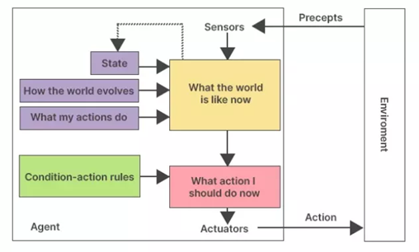
Model-Based Agent Architecture
combining the percept with:
  Old state
  Knowledge from the Transition Model (how the world evolves)
  Knowledge from the Action model (the effect of the agent actions)
Generates a "best guess" about current world state
Updates State so that it would be used in the next cycle

Slide 39
Goal-Based Agents
In addition to:
    sensing the world
    keeping an internal state (model-based agent)
  it also knows the goal:
    What it is trying to achieve (what states of the world are desirable.)
Example:
  The taxi can:
    turn left
    turn right
    go straight
  But the “correct” action depends entirely on the destination.
    At the same intersection:
      left might be correct for one passenger
      right might be correct for another
  So rules like: “If at intersection, turn right”
    are useless without knowing the goal.

Slide 40
Goal-Based Agents
How Goal-Based Decisions Work
  Instead of just reacting, the agent asks:
    What will happen if I do action X?
    → uses a model of how the world evolves
    Will that bring me closer to my goal?
      → checks if future state satisfies or approaches goal
  So the agent evaluates actions based on:
    their consequences, not just current percepts.
  To answer: “What will happen if I do X?”
  the agent must:
    simulate future states
    consider sequences of actions
  This leads to:
    Search → finding a path to a goal (E.g., shortest path algorithms)
    Planning → reasoning about action sequences
  Goal-based agents must reason about the future explicitly.

Slide 41
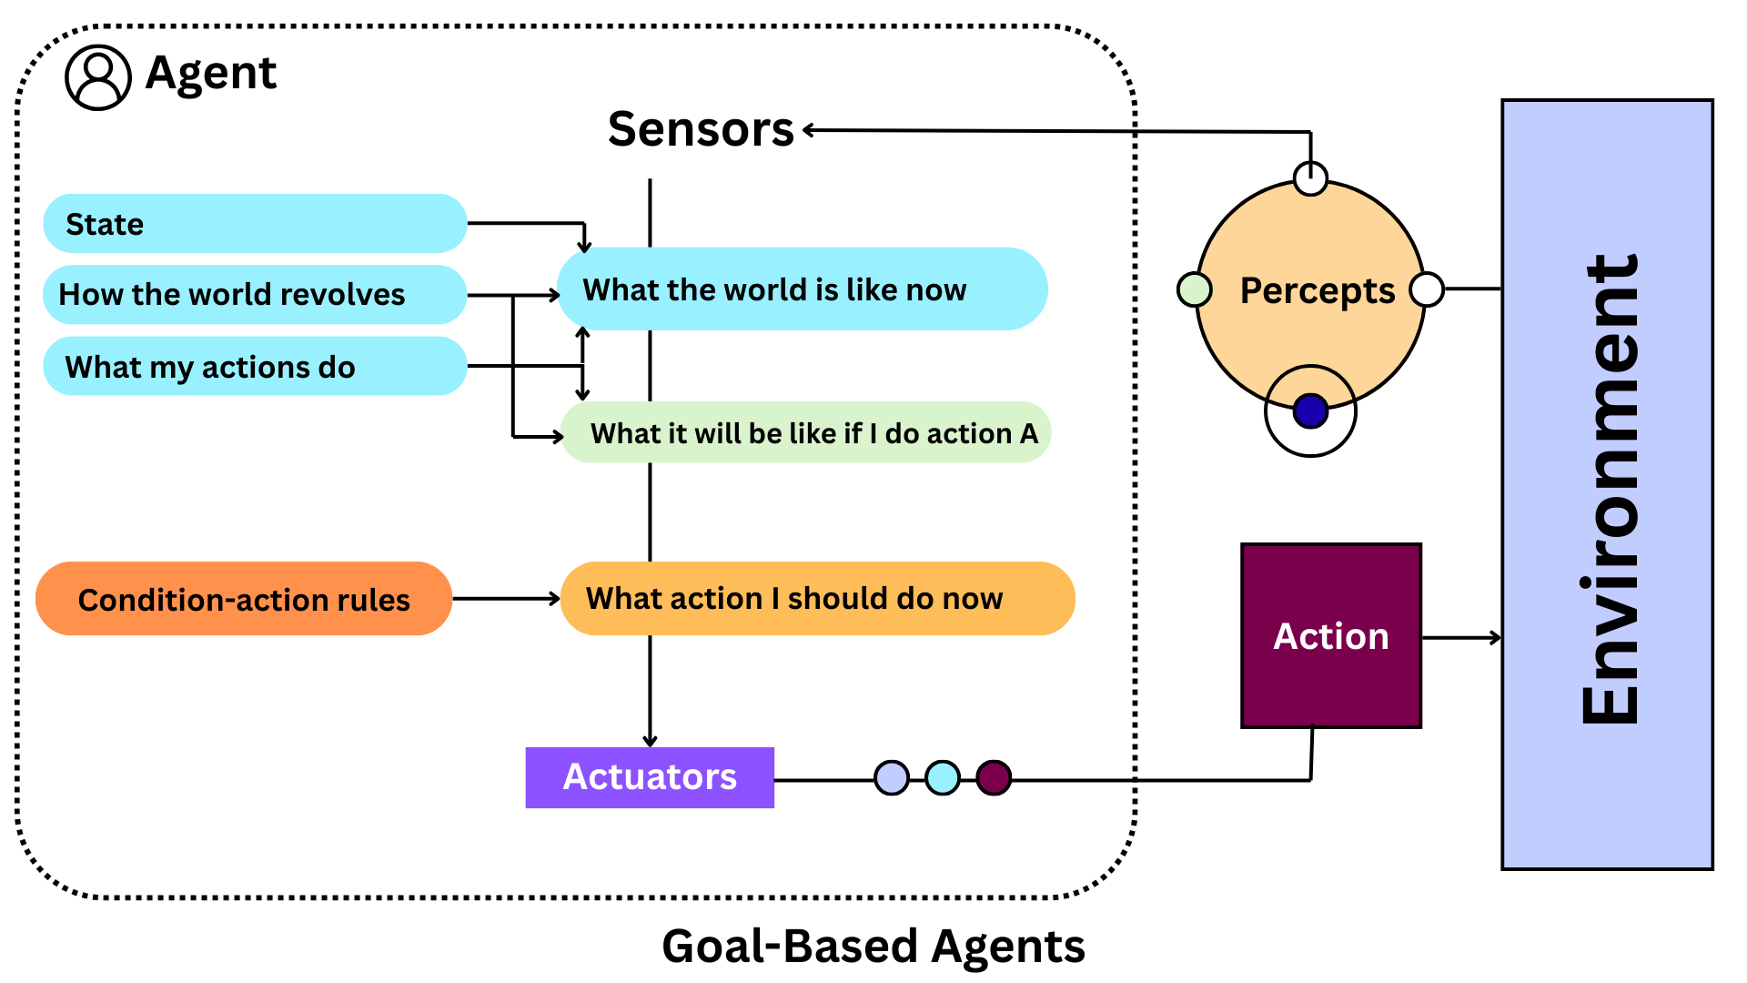
Goal-Based Agent Architecture
Condition is now: current belief + goal evaluation
Condition-action rules are now Decision rules, not simple reflex rules.

Slide 42
Advantages and Limitation
Advantages:
  More flexible than reflex agents
  Knowledge is explicit and modifiable
  Can easily change goals
Limitations
  Goals are usually:
    binary (achieved or not)
  But many real problems involve:
    trade-offs
    degrees of success
  Example:
    fast vs safe vs comfortable driving
  This motivates the next step:
    Utility-based agents, which rank how good different outcomes are.

Slide 43
Advantages and Limitation
  A goal-based agent has no principled way to choose between two actions if both eventually achieve the goal.
    Turn left → eventually reach destination
    Turn right → eventually reach destination
    From the agent’s point of view:
    Goal achieved in both cases → both are acceptable
    There is no built-in preference for:
      shorter vs longer
      safer vs riskier
      cheaper vs expensive
  If no available action satisfies all goals, then a pure goal-based agent has no rational basis to choose among the options.
    It cannot say which failure is “less bad.”
    So in that case, it must rely on arbitrary or ad-hoc rules, not rational optimization.

Slide 44
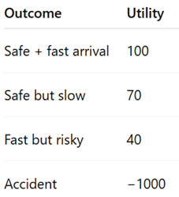
Utility-Based Agents
Problem with Goals:
  Binary success/failure
  goals alone cannot express:
    preferences
    trade-offs
    degrees of success
Solution: Utility
  A utility function:
    Maps each possible world state to a real number representing how desirable that state is.
  So instead of: good vs bad
  we have: better vs worse, by degree
This means the agent now has a numeric measure of happiness or desirability for outcomes.

Slide 45
Utility-Based Agents
Problem with Goals:
  Binary success/failure
  goals alone cannot express:
    preferences
    trade-offs
    degrees of success
Solution: Utility
  A utility function:
    Maps each possible world state to a real number representing how desirable that state is.
  So instead of: good vs bad
  we have: better vs worse, by degree
This means the agent now has a numeric measure of happiness or desirability for outcomes.

Slide 46
Utility-Based Agents
Utility Internalizes the Performance Measure
  Instead of evaluating performance only after the fact, the agent now:
    Uses the performance criteria inside its decision process.
  So the agent doesn’t just ask: “Will I reach the goal?”
  It asks: “How good will the result be?”
  This makes decision making more precise and flexible.
Utility Handles:
  Conflicting goals: Can't achieve all (e.g., speed vs. safety)
  Outcomes are probabilistic: Actions do not guarantee results.
    Taking highway may be faster, but traffic might appear
  Trade-offs Between Risk and Reward:
    Expected utility = likelihood × desirability
    Choose actions that give good outcomes with high probability
Rational agent:
  Chooses action that maximizes expected utility

Slide 47
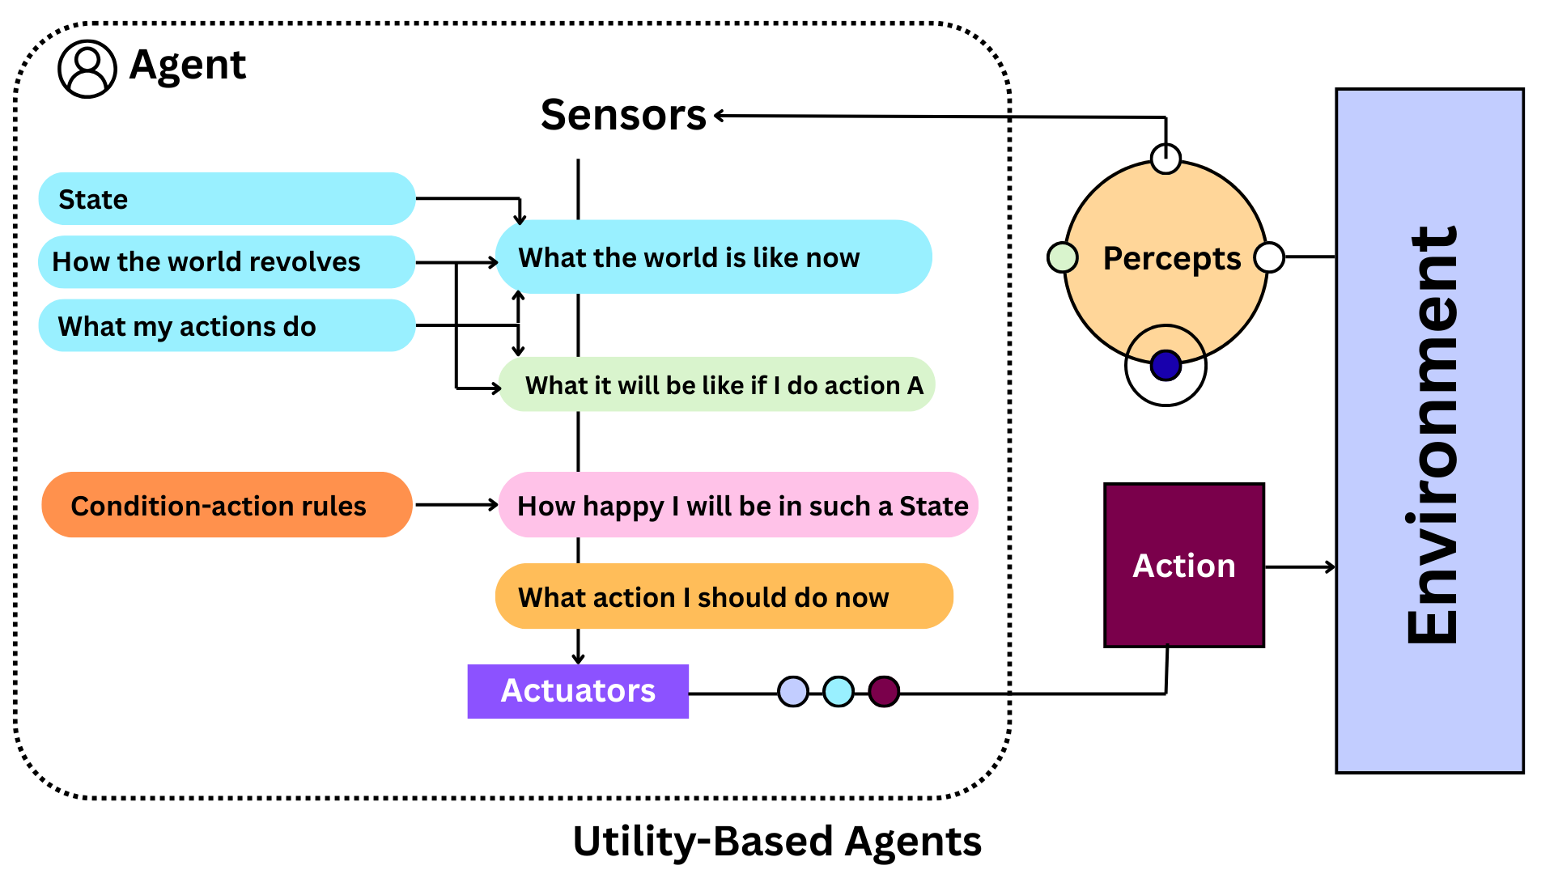
Utility-Based Agent Architecture
Condition-action rules now help evaluate states, not choose action.
  They can encode things like:
    how to recognize dangerous situations
    how to detect comfort levels
  These feed into: utility evaluation, not direct action selection.

Slide 48
Utility vs. Goal-Based Agents
Goal-Based:
  Binary: goal achieved or not
  Simpler to specify
  Sufficient for deterministic, fully observable environments
Utility-Based:
  Degree of satisfaction
  Handles uncertainty naturally
  Required for conflicting goals
  More general framework
Both require:
  Model of environment
  Planning/search capabilities

Slide 49
Learning Agents
A learning agent is best thought of as:
  a wrapper around another agent architecture
It can modify its own behavior based on experience.
  So instead of being fixed at design time, it gets better while operating.
A learning agent:
  1. Operate in initially unknown environments
  2. Become more competent over time
  3. Compensate for incomplete prior knowledge
  4. Adapt to changes

Slide 50
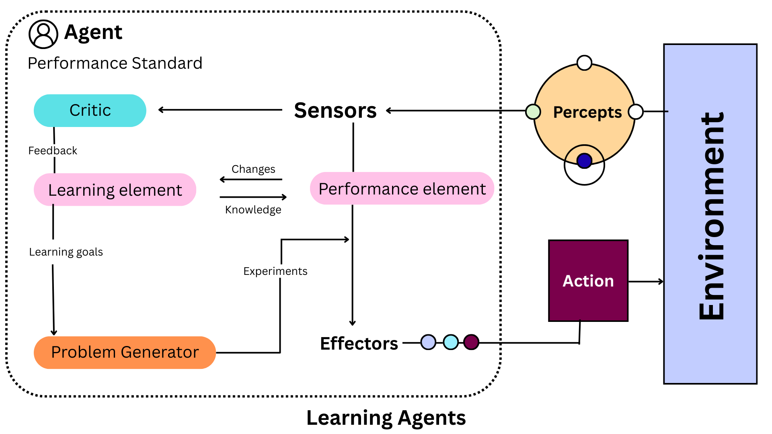
Learning Agent Components

Slide 51
Learning Element Details
Performance Element:
  The "agent" we've been discussing
  Takes percepts, decides actions
Critic:
  observes what happens in the environment
  evaluates behavior using the performance standard
  The critic does not tell the agent what to do — it only tells the learning element how well agent is doing
Learning Element:
  Uses critic's feedback
  Modifies performance element by improving the model components
    "What my actions do"
    "How the world evolves"
  Better models → better predictions

Slide 52
Critic and Problem Generator
Problem Generator:
  What should I try next to learn more?
  encourages trying new behaviors
  trades off short-term performance for long-term improvement
  Example:
    Try a new route to learn traffic patterns
    Try a risky move to see what happens

